Slide 1





AI INTEGRATED WITH WATER MANAGEMENT SYSTEM
Team :B S KUBENDRAN,kubendrankubendran028@gmail.com.
Guide:(P. Raja, Master Trainer, Edu net Foundation)
Disclaimer: The content is curated for educational purposes only.
Notes:
Slides: Prepare a short slide deck (10-12 slides) summarizing the project objectives, methodology, and key results.

Slide 2
OUTLINE
Abstract of the Project
Problem Statement
Proposed Solution
System Architecture
Live Demo of the Project
Embedded Video of Project
Conclusion
Future Scope

Slide 3
Abstract
The integration of Artificial Intelligence (AI) into water management systems offers significant advancements in optimizing water distribution, monitoring quality, and enhancing sustainability. AI-driven solutions, such as machine learning algorithms and predictive analytics, enable real-time data processing from sensors and IoT devices, allowing for efficient water usage, leak detection, and demand forecasting. AI can also assist in water quality monitoring by identifying contamination patterns and predicting potential risks. By automating decision-making processes, AI enhances operational efficiency, reduces waste, and supports better resource allocation, ultimately contributing to more resilient and sustainable water management practices in both urban and rural settings.

Slide 4
Problem Statement
Water scarcity, pollution, and inefficient resource management are growing global challenges that demand innovative solutions for sustainable water management. Traditional water management systems often rely on manual data collection, static models, and reactive measures, leading to inefficiencies, water waste, and slow response times to critical issues such as leaks, contamination, or demand fluctuations. Despite advancements in sensor technologies, existing systems struggle to integrate real-time data, perform accurate predictive analytics, and optimize water distribution across large and complex networks. The need for an intelligent, adaptive system that can continuously monitor water quality, detect anomalies, and forecast future demands in real-time is crucial to ensure more efficient, sustainable, and resilient water resource management. AI-powered solutions present a promising approach, but challenges remain in integrating these technologies with existing infrastructure and ensuring they can scale across diverse environments and conditions.

Slide 5
Proposed Solution
Integrating AI into water management systems enables real-time monitoring, predictive analytics, and optimized resource allocation, addressing key challenges such as water scarcity, inefficiency, and quality control. AI-driven systems use IoT sensors to detect leaks, contamination, and equipment failures instantly, while machine learning models predict water demand and quality trends, ensuring more efficient distribution and reducing waste. By automating decision-making and optimizing operations, AI helps utilities improve water management, enhance sustainability, and respond proactively to issues, ultimately leading to cost savings and more resilient water infrastructure.

Slide 6
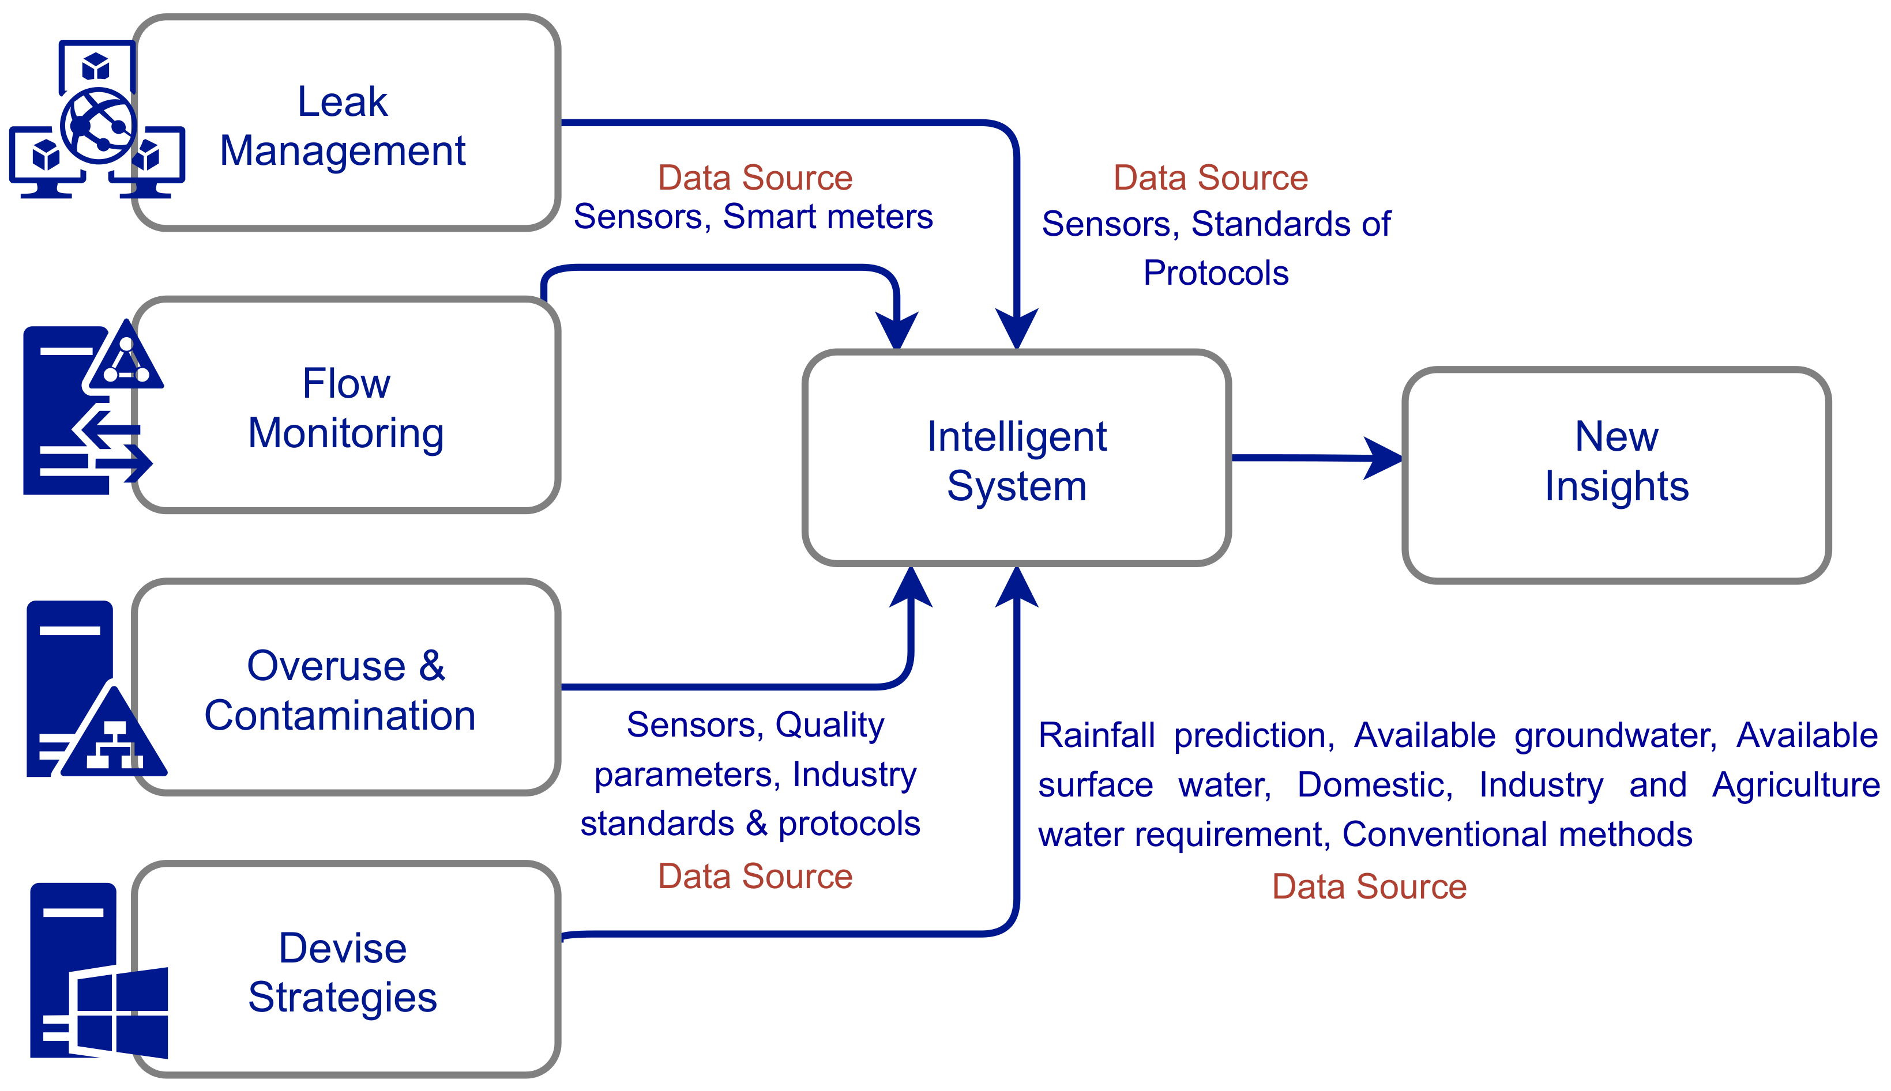
System Architecture

Slide 7
Live Demo of Project

Slide 8
Video of Project Demo

Slide 9
Conclusion
The integration of AI into water management systems represents a significant step toward addressing the growing challenges of water scarcity, inefficiency, and environmental sustainability. By harnessing real-time data, predictive analytics, and machine learning, AI enables more responsive, efficient, and proactive management of water resources. It not only optimizes water distribution, reduces waste, and detects quality issues but also enhances decision-making and long-term planning. As AI technologies continue to evolve, they hold the potential to revolutionize water management, providing smarter, more sustainable solutions that are critical for securing water resources for future generations. However, successful implementation requires overcoming challenges such as infrastructure integration, data quality, and scalability, which must be addressed for AI's full potential to be realized in diverse settings.

Slide 10
Future Scope
The future of AI in water management promises to revolutionize the sector with advanced predictive analytics, autonomous system operations, and enhanced climate adaptation strategies. AI will enable smarter water distribution by predicting demand patterns and managing resources more efficiently, especially in response to climate change. Integration with IoT and smart city technologies will allow real-time monitoring and optimization of water usage across urban and rural areas. AI will also improve water quality management through early detection of contaminants and pollution risks. As AI evolves, its role in sustainable irrigation, renewable energy integration, and transparent water usage tracking will further drive efficiencies, reduce waste, and support more resilient, sustainable water systems worldwide.

Slide 11
Thank you!
Notes:
thank you very much for joining this PPT, keep learning.

